Slide 1
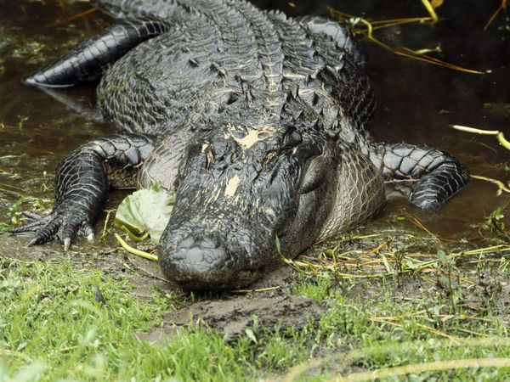
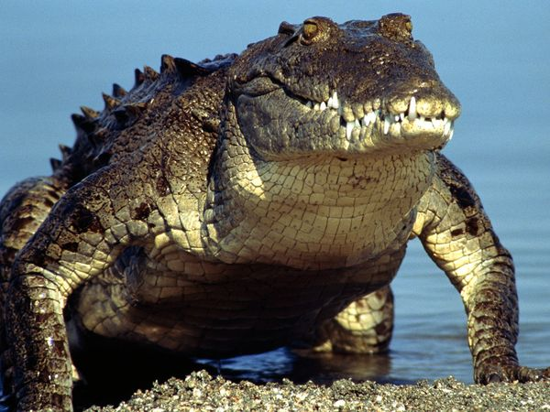
See you later, alligator.
After a while,
crocodile.

Slide 2
See you later, mashed potater.
See you soon, macaroon.

Slide 3
Say goodbye,
pumpkin pie.
Catch you later, operator.

Slide 4
Adios, cinnamon toast.
Can’t stay, blue jay.

Slide 5
Bye-bye, butterfly.
Give a hug, ladybug.

Slide 6
See you soon, racoon.
Time to go, buffalo.

Slide 7
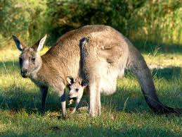
Mañana, iguana.
Toodle-oo, kangaroo.

Slide 8
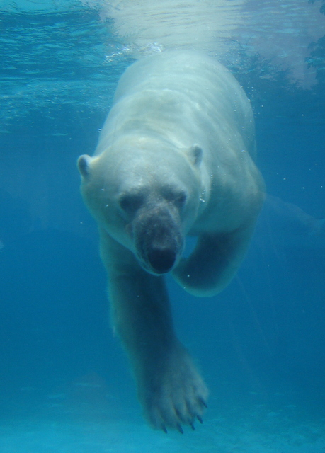
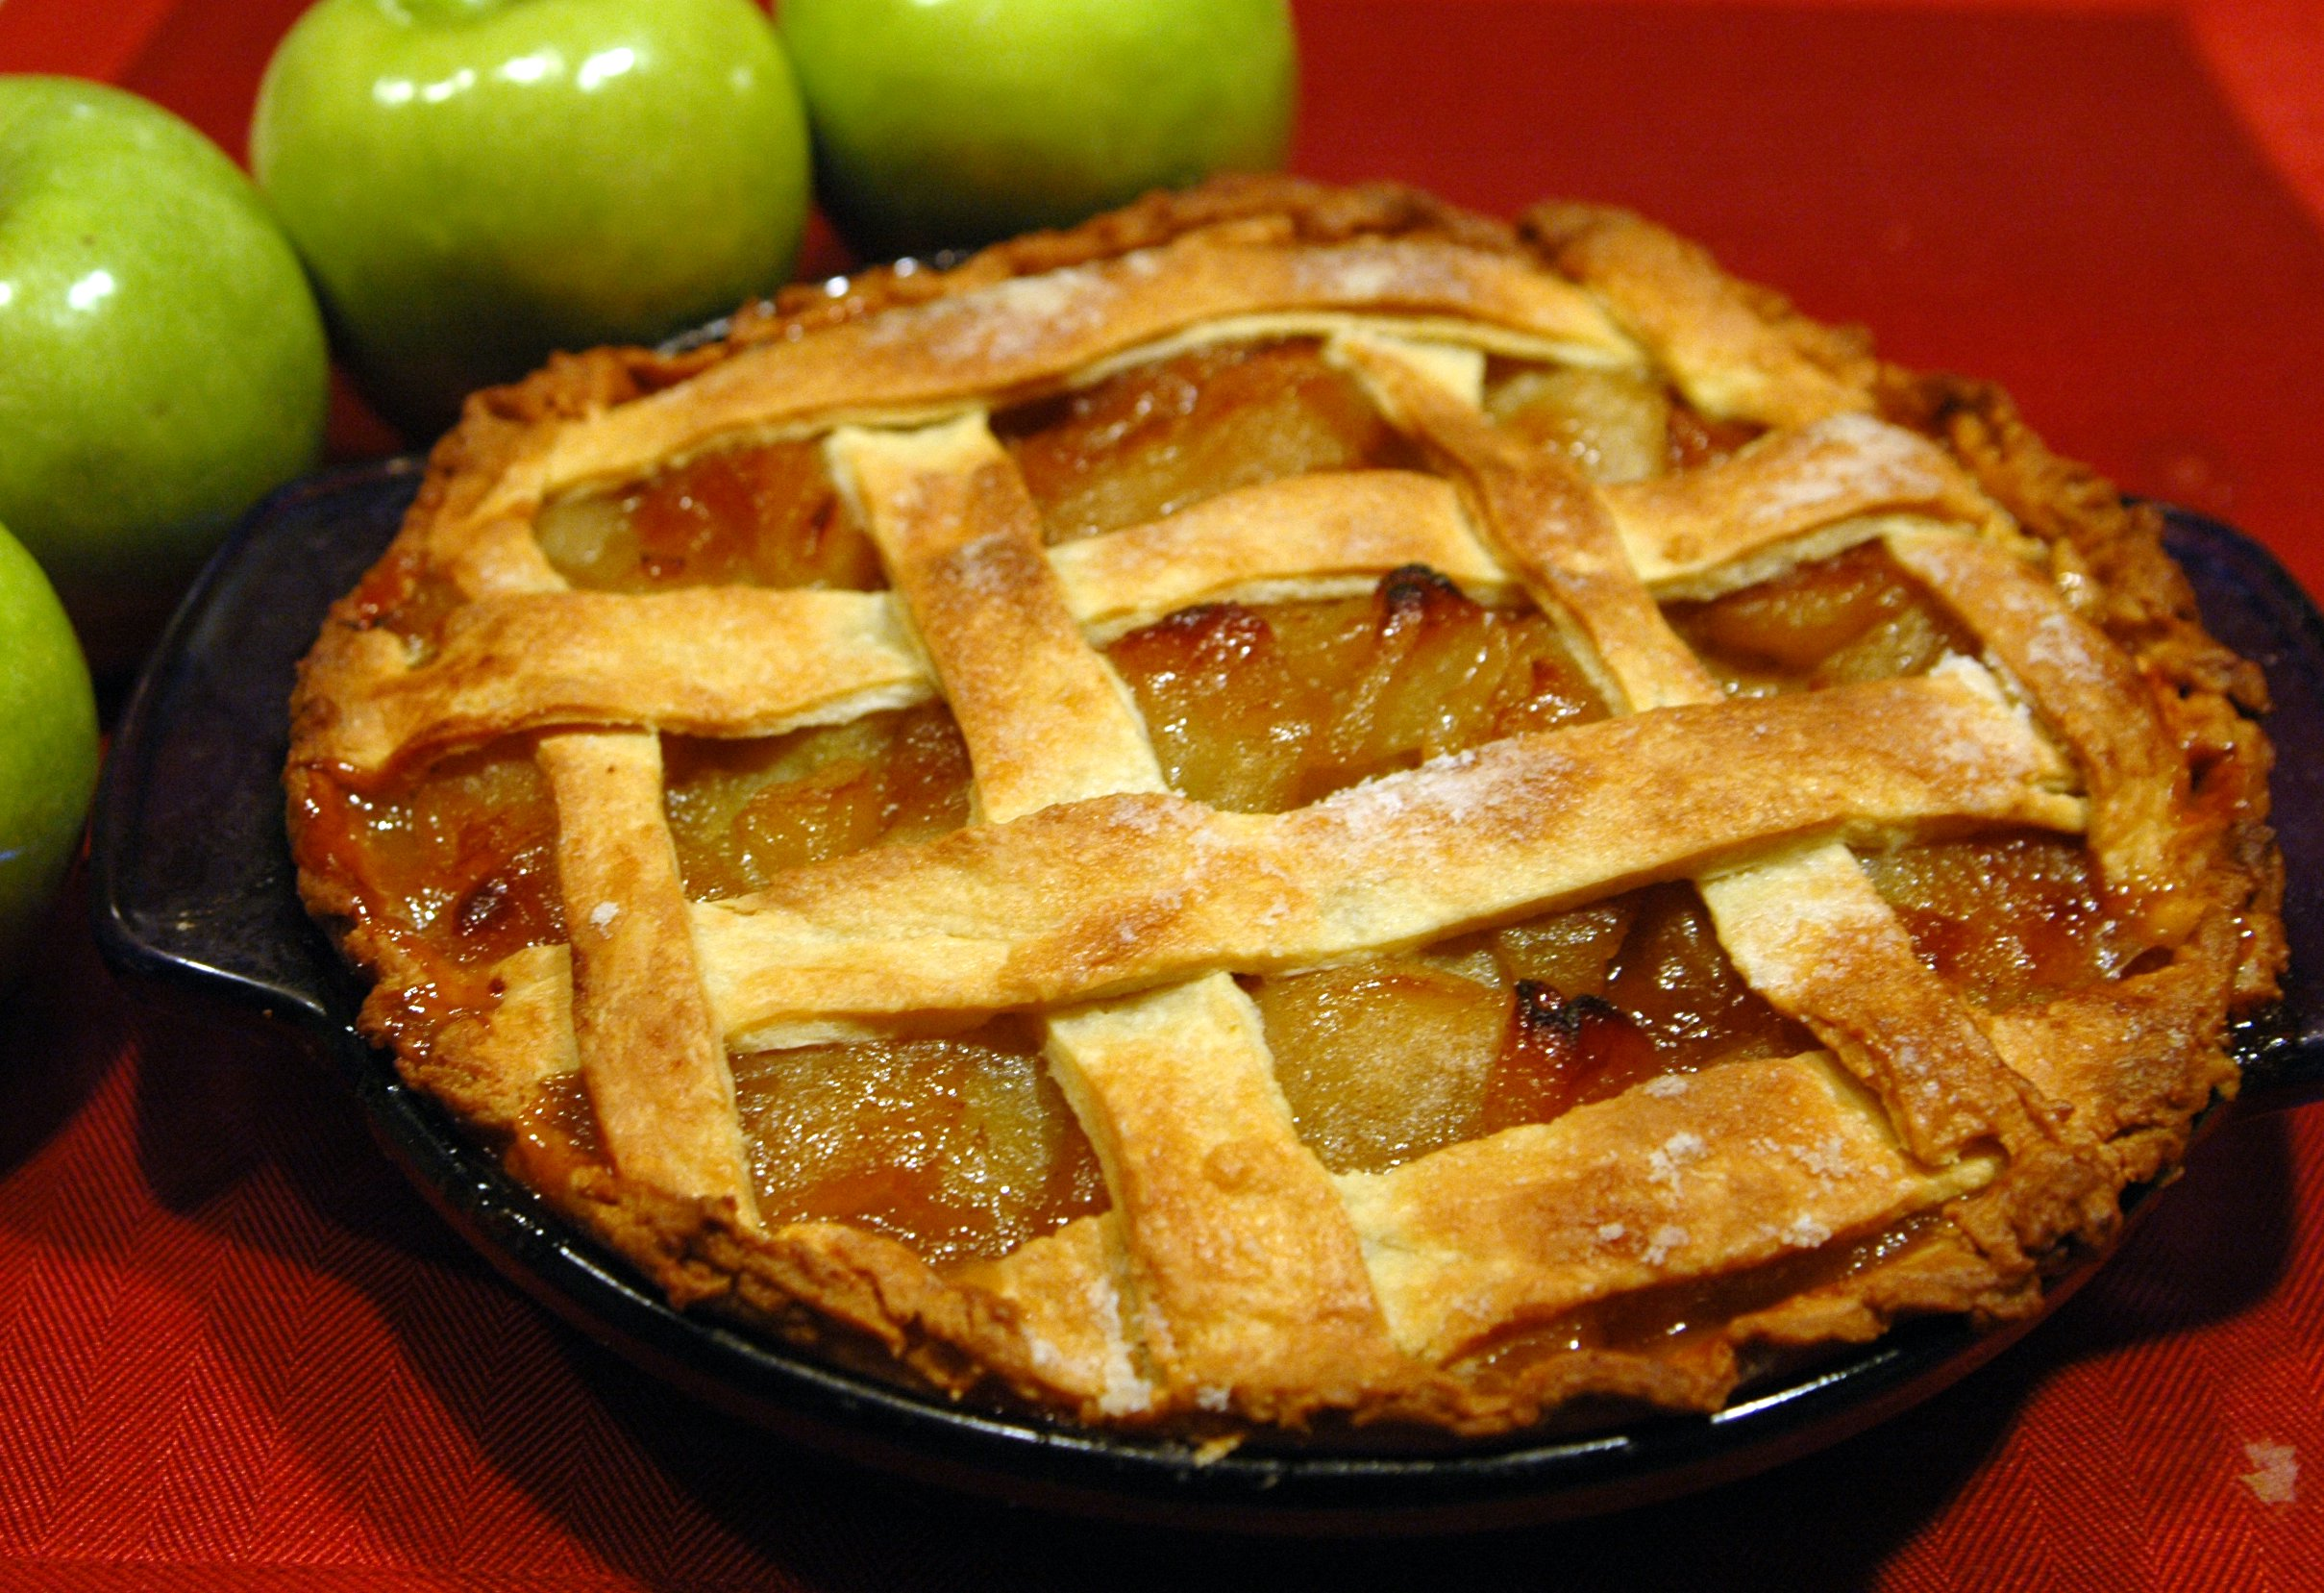
Take care,
polar bear.
Bye-bye,
apple pie.

